Slide 2
Welcome
Hola
Eoseo Osibsio
Yokoso
Bienvenuto
Bienvenue

Slide 4
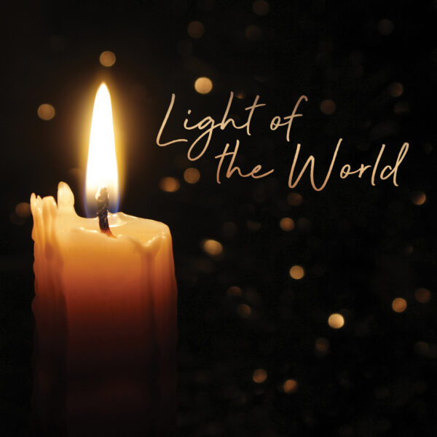

Slide 6
The Lord be with you
And also with you

Slide 7
Let us
pass the peace

Slide 9
12 Extol the LORD, O Jerusalem; praise Your God, O Zion,
13 for God strengthens
the bars of your gates
and blesses your people within you.

Slide 10
14 God grants peace to your borders and satisfies you
with the finest of wheat.
15 God sends His command to the earth; God’s word runs swiftly.

Slide 11
16 God spreads the snow like wool and scatters the frost like ashes.
17 God hurls down hail like pebbles. Who can withstand this icy blast?

Slide 12
18 God sends words and melts them; God stirs up the breezes,
and the waters flow.
19 God has revealed the word to Jacob, God’s laws and decrees to Israel.

Slide 13
20 God has done this
for no other nation; they do not know God’s laws. Praise the LORD.
Amen.

Slide 15
Praise, my soul, the King of heaven, To His feet my tribute bring; Ransomed, healed, restored, forgiven, Who like me His praise should sing? Alleluia! Alleluia! Praise the everlasting King.1/4

Slide 16
Praise Him for His grace and favour To our fathers in distress; Praise Him still the same as ever, Slow to chide, and swift to bless: Alleluia! Alleluia! Glorious in His faithfulness. 2/4

Slide 17
Father-like, He tends and spares us, Well our feeble frame He knows; In His hands He gently bears us, Rescues us from all our foes: Alleluia! Alleluia! Widely as His mercy flows. 3/4

Slide 18
Angels, help us to adore Him; Ye behold Him face to face; Sun and moon, bow down before Him, Dwellers all in time and space: Alleluia! Alleluia! Praise with us the God of grace. 4/4

Slide 21
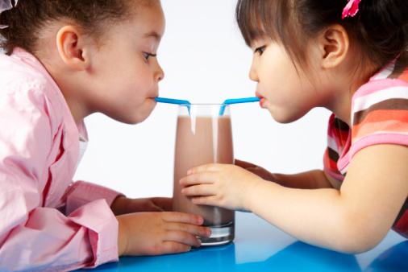

Slide 22
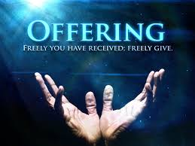

Slide 25
²¹ Do you not know? Have you not heard? Has it not been told you from the beginning? Have you not understood since the earth
was founded? ²² He sits enthroned above the circle of the
earth, and its people are like grasshoppers. He stretches out the heavens like a canopy, and spreads them out like a tent to live in.

Slide 26
²³ He brings princes to naught and reduces the rulers
of this world to nothing. ²⁴ No sooner are they planted, no sooner are they sown, no sooner do they take root in the ground, than he blows on them and they wither, and a whirlwind sweeps
them away like chaff.
²⁵ “To whom will you compare me? Or who is my equal?” says the Holy One.

Slide 27
²⁶ Lift up your eyes and look to the heavens: Who created all these? He who brings out the starry host one by one and calls forth each of them by name. Because of his great power
and mighty strength, not one of them is missing.
²⁷ Why do you complain, Jacob? Why do you say, Israel, “My way is hidden from the Lord; my cause is disregarded by my God”?

Slide 28
²⁸ Do you not know?
Have you not heard? The Lord is the everlasting God,
the Creator of the ends of the earth. He will not grow tired or weary, and his understanding no one can fathom. ²⁹ He gives strength to the weary and increases the power of the weak. ³⁰ Even youths grow tired and weary, and young men stumble and fall;

Slide 29
³¹ but those who hope in the Lord will renew their strength. They will soar on wings like eagles; they will run and not grow weary, they will walk and not be faint.

Slide 32
⁴³ The next day Jesus decided to leave
for Galilee. Finding Philip, he said to him,
“Follow me.”
⁴⁴ Philip, like Andrew and Peter, was from the town of Bethsaida.
⁴⁵ Philip found Nathanael and told him,
“We have found the one Moses wrote about in the Law, and about whom the prophets also wrote—Jesus of Nazareth, the son of Joseph.”

Slide 33
⁴⁶ “Nazareth! Can anything good come from there?” Nathanael asked.
“Come and see,” said Philip.
⁴⁷ When Jesus saw Nathanael approaching,
he said of him, “Here truly is an Israelite in whom there is no deceit.”
⁴⁸ “How do you know me?” Nathanael asked.
Jesus answered, “I saw you while you were still under the fig tree before Philip called you.”

Slide 34
⁴⁹ Then Nathanael declared, “Rabbi, you are the Son of God; you are the king of Israel.”
⁵⁰ Jesus said, “You believe
because I told you I saw you under the fig tree. You will see greater things than that.”
⁵¹ He then added, “Very truly I tell you, you will see ‘heaven open, and the angels of God ascending and descending on’ the Son of Man.”

Slide 36
I, the Lord of sea and sky,
I have heard my people cry.
All who dwell in dark and sin
My hand will save.
I who make the stars of night,
I will make their darkness bright.
Who will bear my light to them?
Whom shall I send? 1/6

Slide 37
Here I am, Lord. Is it I, Lord?
I have heard you calling in the night.
I will go, Lord, if you lead me.
I will hold your people in my heart.
2/6

Slide 38
I, the Lord of snow and rain,
I have borne my people's pain.
I have wept for love of them.
They turn away.
I will break their hearts of stone,
Give them hearts for love alone.
I will speak my word to them.
Whom shall I send? 3/6

Slide 39
Here I am, Lord. Is it I, Lord?
I have heard you calling in the night.
I will go, Lord, if you lead me.
I will hold your people in my heart.
4/6

Slide 40
I, the Lord of wind and flame,
I will tend the poor and lame.
I will set a feast for them.
My hand will save.
Finest bread I will provide
Till their hearts be satisfied.
I will give my life to them.
Whom shall I send? 5/6

Slide 41
Here I am, Lord. Is it I, Lord?
I have heard you calling in the night.
I will go, Lord, if you lead me.
I will hold your people in my heart.
6/6
Daniel Schutte 1947-

Slide 44
⁴³ The next day Jesus decided to leave for Galilee. Finding Philip, he said to him,
“Follow me.” quite simple !!
⁴⁴ Philip, like Andrew and Peter, was from the town of Bethsaida, in the north near the Decapolis and Phil and Andrew are Greek names and they later are asked for an intro to Jesus (12:20-22).
There is nothing spectacular abt anyone in the world, each has their own ordinariness and that is what is used.

Slide 45
⁴⁵ Philip found Nathanael and told him,
“We have found the one Moses wrote about in the Law, and about whom the prophets also wrote, the two most important parts of Hebrew scripture—Jesus of Nazareth, the son of Joseph, so Jesus’ name should be Jesus Josephson or Barjoseph, a human connection, but, he is the Son of God. .”

Slide 46
⁴⁶ “Nazareth! Can anything good come from there?” Nathanael asked. We don’t know what happened here, but, he moves straight on….. The point is missed….
“Come and see, a simple request, no hidden agenda,” said Philip.
⁴⁷ When Jesus saw Nathanael approaching, he said of him, “Here truly is an Israelite in whom there is no deceit.”, teacher here greets the disciple.

Slide 47
⁴⁸ “How do you know me?” Nathanael asked.
Why do you think?
Jesus answered, “I saw you while you were still under the fig tree before Philip called you.”
⁴⁹ Then Nathanael declared, “Rabbi, you are the Son of God; you are the king of Israel.”
All 3 are Messianic titles.

Slide 48
⁵⁰ Jesus said, “You believe because
I told you I saw you under the fig tree.
You will see greater things than that.”
⁵¹ He then added, “Very truly, most certainly, or Amen, I tell you, plural
, you will see ‘heaven open, and the angels of God ascending and descending, like Jacob Gen 28:12, on’ the Son of Man, not on a ladder, but, direct to him..”
Following is the wedding in Cana, was Nathanael there?

Slide 50
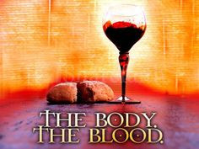
DO THIS IN REMEMBRANCE OF ME.

Slide 51
Here, Lord we take the broken bread
And drink the wine, believing
That by your life our souls are fed,
Your parting gifts receiving.
1/2

Slide 52
As You have given, so we would give
Ourselves for others’ healing;
As You have lived, so we would live
The Father’s love revealing.
2/2

Slide 56
Holy, holy, holy Lord,
God of power and might,
Heaven and earth
are full of your glory.
Hosanna in the highest.

Slide 57
Blessed is He
who comes in the name of the Lord.
Hosanna in the highest.

Slide 59
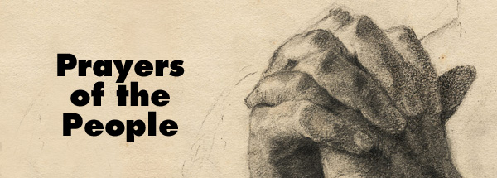

Slide 60
Our Father in heaven,
hallowed be Your name,
Your kingdom come,
Your will be done
On earth as in heaven.
Give us today our daily bread.

Slide 61
And forgive us our sins,
As we forgive those
who sin against us.
Save us from the time of trial,
And deliver us from evil.
For the kingdom, the power
and the glory are Yours,
Now and forever. Amen.

Slide 65
At the Name of Jesus
Every knee shall bow,
Every tongue confess Him
King of glory now;
'Tis the Father's pleasure
We should call Him Lord,
Who from the beginning
Was the mighty Word. 1/5

Slide 66
Humbled for a season,
To receive a Name
From the lips of sinners,
Unto whom He came,
Faithfully He bore it
Spotless to the last,
Brought it back victorious,
When from death He passed; 2/5

Slide 67
Name him, brothers, name Him,
With love as strong as death,
But with awe and wonder
And with bated breath;
He is God the Saviour,
He is Christ the Lord,
Ever to be worshipped,
Trusted, and adored. 3/5

Slide 68
In your hearts enthrone Him;
There let Him subdue
All that is not holy,
All that is not true;
Crown Him as your Captain
In temptation's hour;
Let His will enfold you
In its light and power. 4/5

Slide 69
Brothers, this Lord Jesus
Shall return again,
With His Father's glory
With His angel train;
For all wreaths of empire
Meet upon His brow,
And our hearts confess Him
King of glory now. 5/5

Slide 71
Join us for morning tea

